Slide 1
AerospikeXDR

Slide 2
Some Background
(AKA Aero-What?)
Aerospike is a Distributed Key-Value no-sql database and support all the CRUD(create\read\update\delete) operations.
Records always belong to “Namespace”(something like schema in sql) and may grouped by some “Set”
The Key in Aerospike represented as a “digest”(byte array value) build from the “userkey” which the client provided and the “Set” name that it should be stored in.
The Value is A record while the data within it holds one or more items in "Bins".
Currently use by:
CT Core-Pipeline (WebRecorder stores clients’ recordings for Processor to process them)
Malka (PVBuilder stores clients’ recordings for PVWriter to process them and timeout sessions didn’t acknowledged as finished)

Slide 3
Ok… I think I got it…
So what is XDR?

Slide 4
“XDR is A short of “Cross Datacenter Replication” which is a fancy word for replicate data from Aerospike cluster to another”
—Nir Orfaly

Slide 5
XDR What is it good for?
Wait!
Change notification?
This is what the usage of timeout in Malka!
DR Usage - Backup cluster for failover.
Read\Write per data center.
Change notification feature to implement pub-sub type data model

Slide 6
Lets see some demo?
Hope it will works...

Slide 7

Now Lets Work(shop)

Slide 8
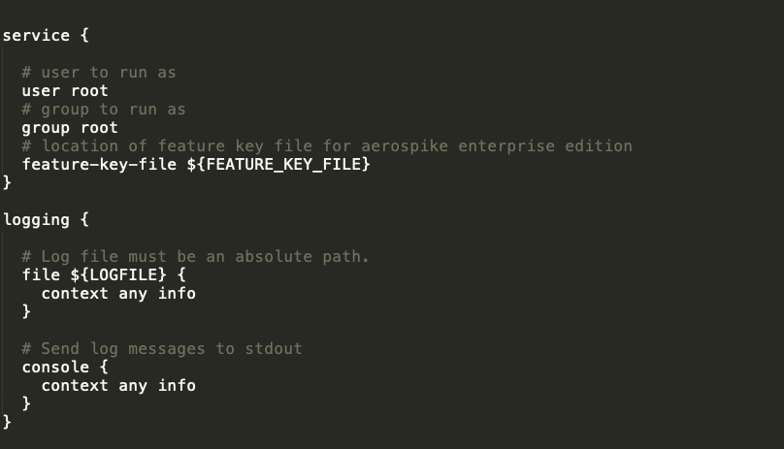
Service + logging Conf

Slide 9
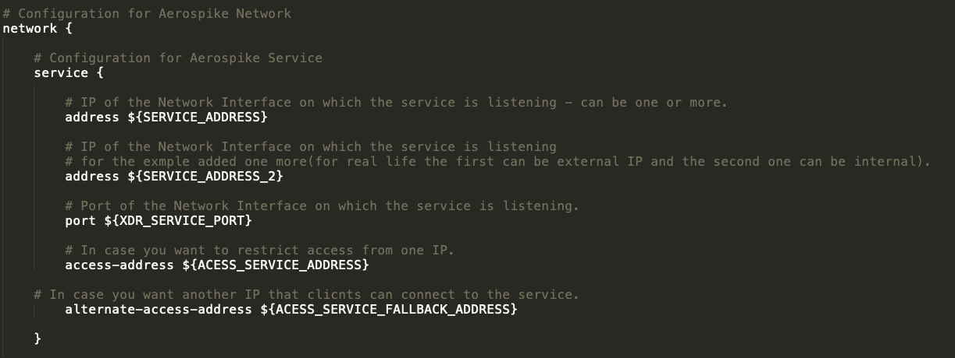
Networks Conf(1/2)

Slide 10
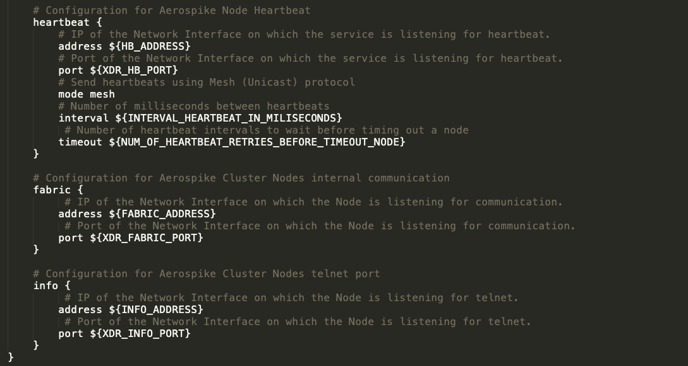
Networks Conf(2/2)

Slide 11
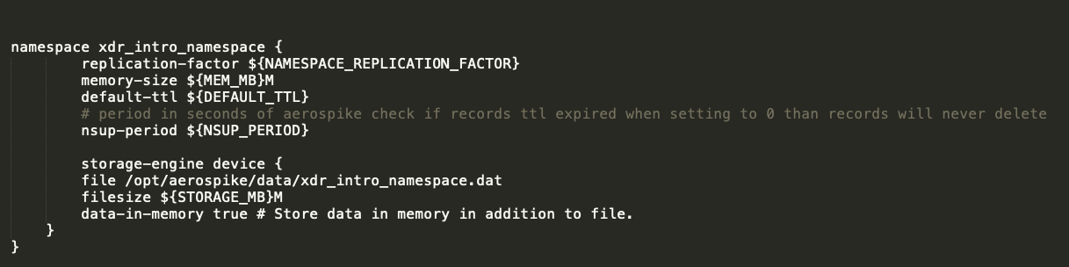
Namespace Conf

Slide 12
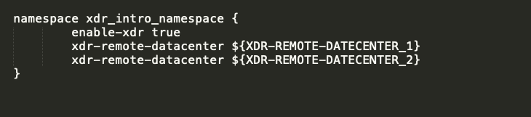
XDR-Namespace Conf

Slide 13
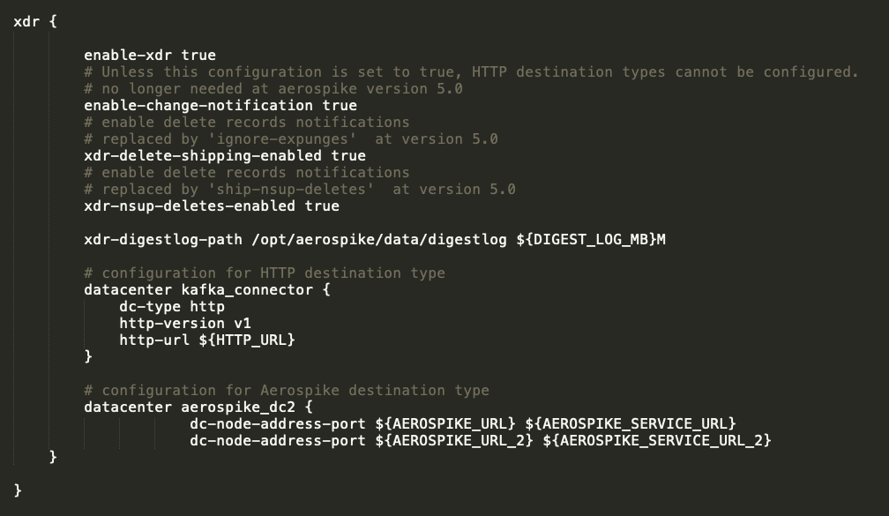
XDR Conf

Slide 14
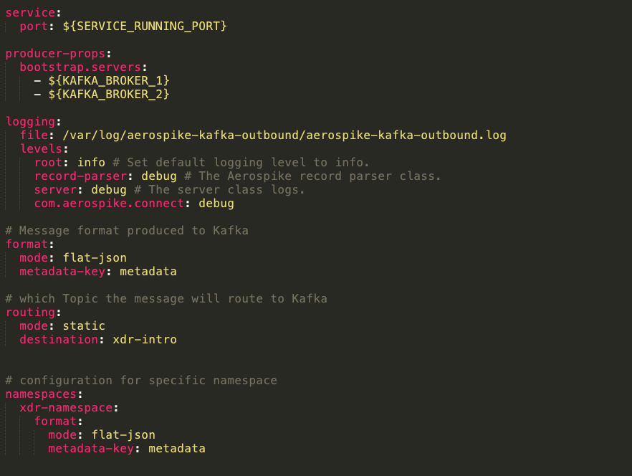
Kafka Connector XDR Conf

